Slide 1

Using and Developing Community Assessments for Effective Planning, Implementation and Evaluation
March 10, 2015
VIera, Florida

Slide 2

Background
In Head Start, there is a move towards more accountability and a push for data‐driven decision‐making.
ICF and Region IV established a Data Institute and reached over 100 grantees.
Overall purpose was to apply different data process concepts and related tools to the construction of a data action plan and to observe basic techniques of data analysis to real-life Head Start examples analyze data in an integrated manner in order to make better program decisions

Slide 3
What we learned?
The saying that HS programs are “data rich” and “information poor,” while ironic, is often true
Programs need to move away from a unitary focus on data by a single person or division
A data-driven culture can be achieved regardless of a program’s resources, structure or size
www.noloconsulting.com

Slide 4
Not Effective Use of Data
Collected data to satisfy compliance.
Data flowed upward from local program to the federal government; but it wasn’t used at the program level.
Data were not delivered to users in a timely manner, and programs did not feel comfortable with the quality of the data.

Slide 5
Effective Use of Data
Programs collect and analyze data in order to answer critical questions.
Data turnaround is fast.
Information is presented so that it can be used by staff, teachers, parents, governing bodies, and policy groups in real time.
Notes:
“Rethinking data this way, analysis is richer and programs are able to use the information they gathered from the data to set strategic directions, find systemic solutions, answer critical questions, and continually improve their services to children and families.”

Slide 6
Conditions / Elements for
Data-Driven Success
Culture (leadership)
Quality (data and information rich)
Capacity (data team and plan/process)

Slide 7
How do you build a Data Driven Culture in your HS/EHS program?
Establish the vision
Research and learn from others’ successes
Determine ideal infrastructure
Ensure buy-in from staff
Foster professional development and address needs
Lead by example and encourage data utilization
Establish data meetings
Remove or modify barriers to effective data use
www.noloconsulting.com

Slide 8
Data-driven Decision Making
An organization best work is based on systematic and active planning, accurate assessment of need, and community knowledge.
Data-supported decision-making is a continuous process of assessing, prioritizing, planning, implementing, evaluating and reporting

Slide 9
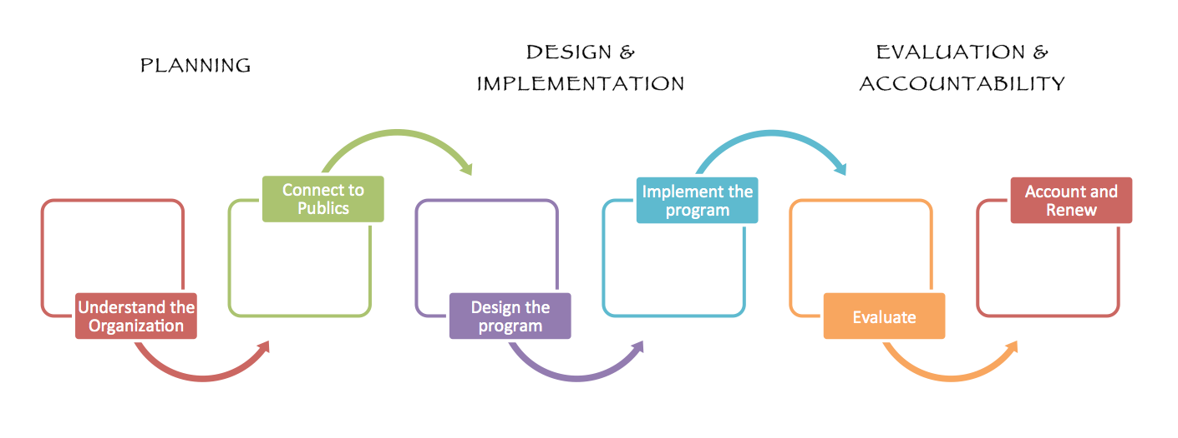
www.noloconsulting.com

Slide 10
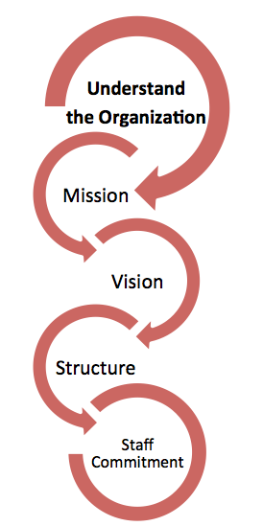
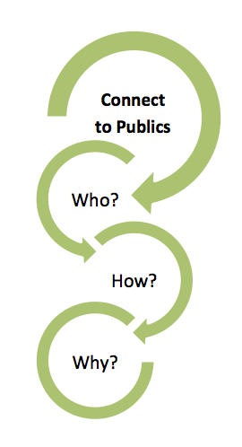
PLANNING: Understand the Organization
PLANNING: Connect to Publics

Slide 11
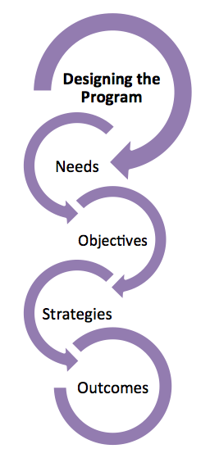
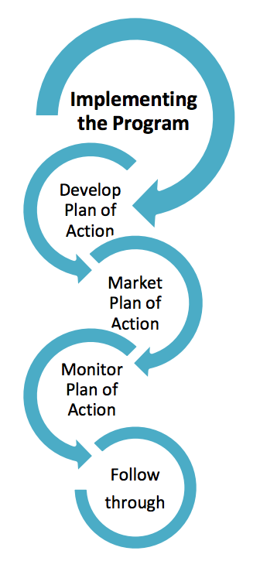
DESIGN & IMPLEMENTATION

Slide 12
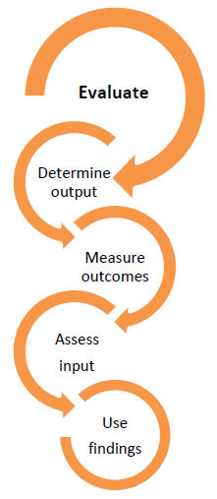
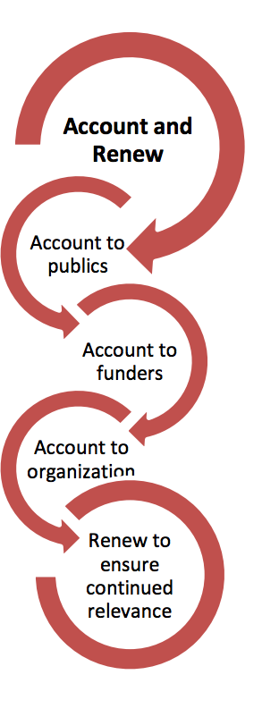
EVALUATION AND ACCOUNTABILITY

Slide 14
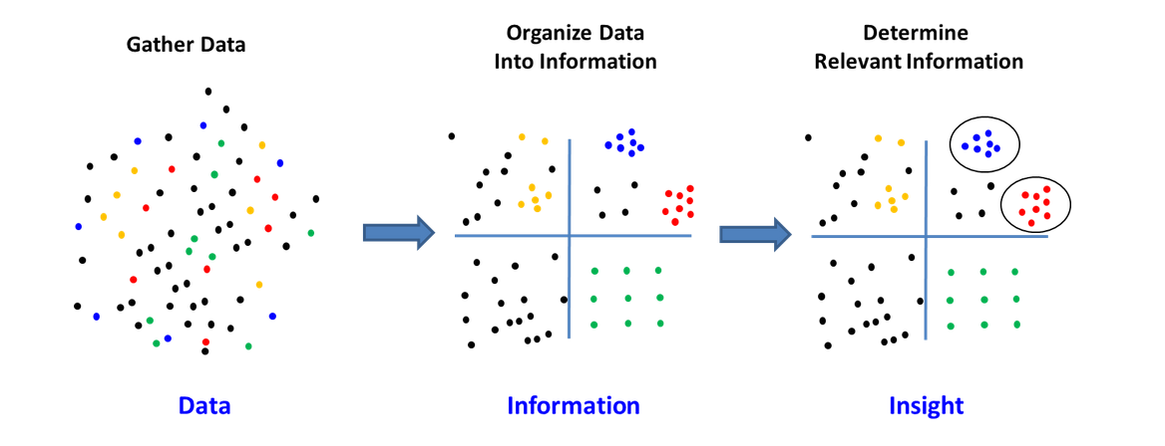
Region IV Data Institute Experience
What are data?
How do you find or collect data?
How do you analyze data?
How do you understand and apply data?

Slide 15
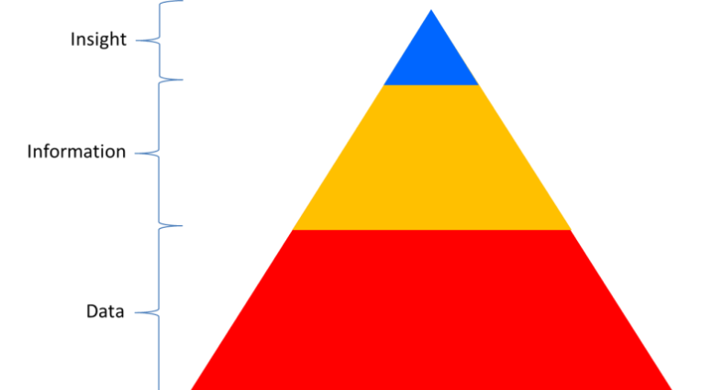
The Actionable Insight
Gather data
➔
De-duplicate and collate
➔
Refine into an action plan

Slide 16
How valuable are data?
Priority setting
Strategic development
Comprehensive planning
Performance evaluation
Service delivery modeling and strategy
Resource allocation
Statements of need
Funding applications
Quality management
Leveraging resources
Advocacy
Identifying collaborative partners and allies
Mapping the locus of local power and identification of power brokers
Improving community responsiveness to health care needs across the community

Slide 17
Needs Assessment Process
Brainstorm – The Questions
Finalize the key questions you will ask in your needs assessment
Identify the information sources
Select the information-gathering techniques

Slide 18

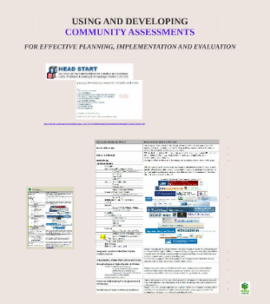
www.noloconsulting.com

Slide 19

Hans Rosling's Demographic Party Trick http://youtu.be/2nDh8MQuS-Y

Slide 20
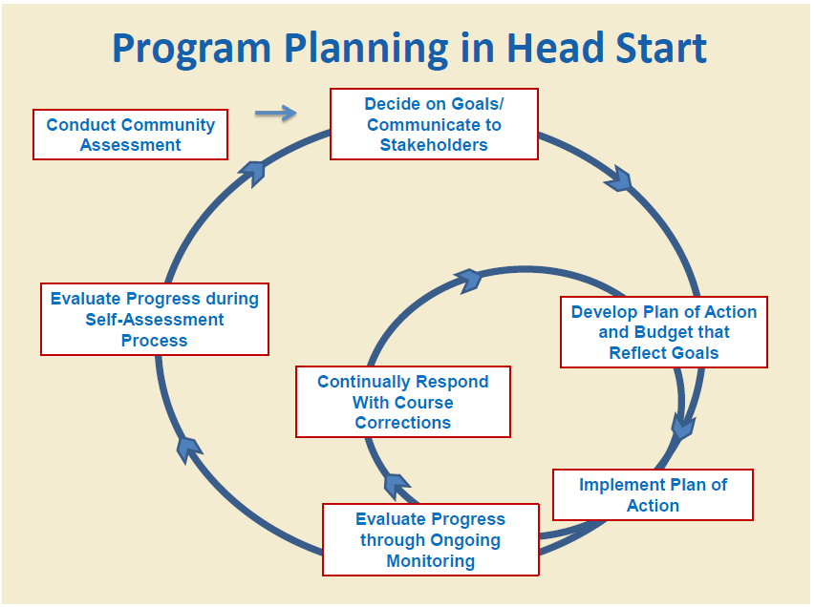

Slide 21
Thinking backwards to move forward
What is the current situation that we intend to impact?
What will it look like when we achieve the desired situation or outcome?
What behaviors need to change for that outcome to be achieved?
What knowledge or skills do people need before the behavior will change?
What activities need to be performed to cause the necessary learning?
What resources will be required to achieve the desired outcome?

Slide 22
Process and Models that support a Data Driven Culture
Logic Model
Data Plan (Four Data Activities – Guiding Questions)
Six Thinking Hats (Eliminate Idea Killers or Adverse Thinking.)
Decision Style Profile
www.noloconsulting.com

Slide 23
Logic Model
A logic model or program matrix is a tool to evaluate the effectiveness of a program.
A graphical depiction of the logical relationships between the resources, activities, outputs and outcomes of a program.
A logic model is to assess the "if-then" (causal) relationships between the elements of the program; if the resources are available for a program, then the activities can be implemented, if the activities are implemented successfully then certain outputs and outcomes can be expected.

Slide 24
Logic Model: 5 Core Components
It displays the sequence of actions that describe what the program is and will do – how investments link to results.
INPUTS: resources, contributions, investments that go into the program
OUTPUTS: activities, services, events and products that reach people who participate or who are targeted
OUTCOMES: results or changes for individuals, groups, communities, organizations, communities, or systems
ASSUPTIONS: the beliefs we have about the program, the people involved, and the context and the way we think the program will work
EXTERNAL FACTORS: the environment in which the program exists includes a variety of external factors that interact with and influence the program action.

Slide 25
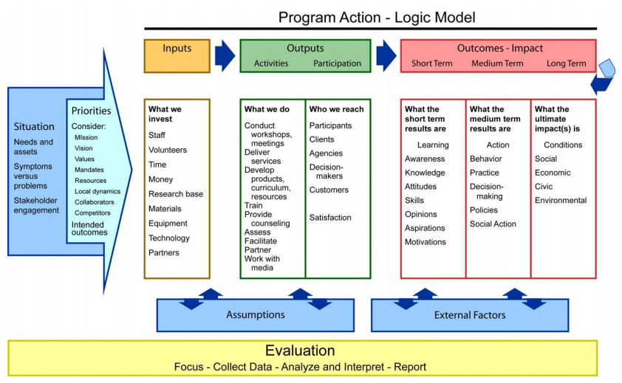

Slide 26
Program Action: Logic Model
Outcomes
Activities/ Outputs
Situation
Inputs
Knowledge & Behavior
Impacts
Identify
Problem
or Need
Invest
Staff,
Volunteers,
Money,
Materials
Deliver
Products
or
Services
Change in
Program
Participants
Change to
Population
or Area
Notes:
In order to distinguish the differences between Outputs, Outcomes, and Impacts we need to understand the continuum of Program Action.
Logic model helps us figure out the results of our programs - what to measure and demonstrate our accountability.
How many people are familiar with the Logic Model? How many use the Logic Model for their Program Development?
Activities & Outputs are often listed separately in Prog. Eval. they are technically different:
Activities are what we do in research Extension Education.
Outputs are what comes out from funded activities, the products or services.
For reporting purposes there is often overlap, like in DANRIS:
Ex. classes. What we did – teach; Output: 10 classes.
Given that ANR’s mission to be an agent of change, all what we do fits in somewhere along this continuum. Often our work is focused on Outputs and Outcomes, but there is till an impact connected to our work.
In the case of a basic research project, you can take an institutional approach to the Logic Model, and think about the team effort that leads to the long-term outcomes.
Or in the case that a prog./proj. is only at the outputs stage use the logic Model to help determine what the outcomes and impacts will be. Please include in Plan.

Slide 27
“Idea Killers”
Good idea, but it’s the same as…
We tried that before.
That’s not how we do it here.
Who will pay for that?
Management will never go for it.
Solution: Six Thinking Hats

Slide 28
Six Thinking Hats
Adversarial Thinking
A B
Parallel Thinking
A
B

Slide 29
Six Thinking Hats
Confusion is the biggest enemy of good thinking
We try to do too many things at a time
    Juggling with six balls at a time is rather difficult
    Tossing up one ball at a time is much easier
    Six Hat Thinking does one thing at a time and in the end the full picture emerges
Encourages parallel thinking
Explores a subject more thoroughly
Makes specific time and space for creative thinking
Separates ego from performance

Slide 30






Six Thinking Hats
White Hat: Looks objectively at data and information. Is neutral and concerned with facts and figures.
Red Hat: Legitimizes feelings and gives an emotional view, hunches, and intuition.
Yellow Hat: Is positive and constructive. The yellow color symbolizes sunshine, brightness and optimism.
Black Hat: Is logical, negative, judgmental, and cautious. Is gloomy, suggests why it cannot be done.
Green Hat: Is about new ideas and creative thinking.
Blue Hat: Controls the thinking process. The blue hat is concerned with control and the organization of the thinking process.

Slide 31

white hat
What information is available?
What information do we need?
How are we going to get the missing
information?

Slide 32
red hat
What are my feelings right now?
What does my intuition tell me?
What is my gut reaction?

Slide 33
black hat
What are some possible problems?
What difficulties could we encounter?
What are points for caution?
What are the risks?

Slide 34

yellow hat
What are the benefits?
What are the positives?
What are the values?
Can this be made to work?

Slide 35

green hat
What creative ideas do we have?
What are the alternatives?
How can we overcome the black hat difficulties?

Slide 36

blue hat
Where should we start?
What is the agenda?
What are the objectives?
Which hats should we use?
How can we summarize?
What should we do next?

Slide 37
Questions? Comments?
www.noloconsulting.com

