Slide 1
Logic Model
Goal Setting Process
www.noloconsulting.com

Slide 2
Logic Model
It displays the sequence of actions that describe what the program is and will do – how investments link to results.

Slide 3
Logic Model
A logic model or program matrix is a tool to evaluate the effectiveness of a program.
A graphical depiction of the logical relationships between the resources, activities, outputs and outcomes of a program.
A logic model is to assess the "if-then" (causal) relationships between the elements of the program; if the resources are available for a program, then the activities can be implemented, if the activities are implemented successfully then certain outputs and outcomes can be expected.
Logic models are most often used in the evaluation stage of a program, they can however be used during planning and implementation.

Slide 4
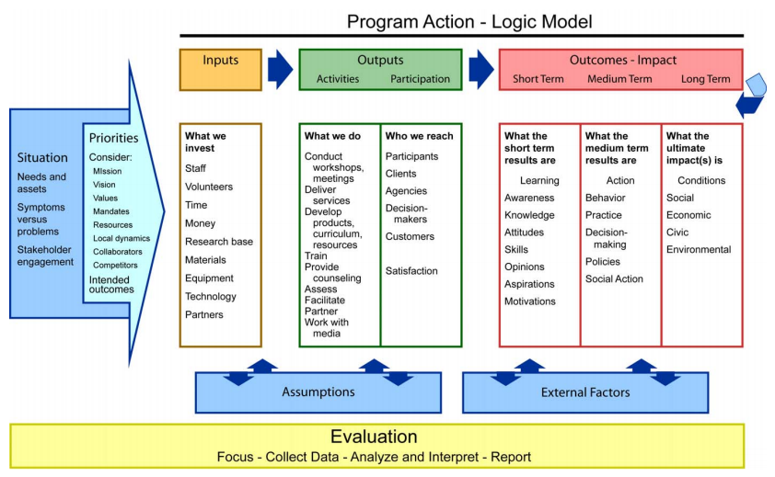

Slide 5
5 Core Components
INPUTS: resources, contributions, investments that go into the program
OUTPUTS: activities, services, events and products that reach people who participate or who are targeted
OUTCOMES: results or changes for individuals, groups, communities, organizations, communities, or systems
Assumptions: the beliefs we have about the program, the people involved, and the context and the way we think the program will work
External Factors: the environment in which the program exists includes a variety of external factors that interact with and influence the program action.

Slide 6
Thinking backwards to move forward
What is the current situation that we intend to impact?
What will it look like when we achieve the desired situation or outcome?
What behaviors need to change for that outcome to be achieved?
What knowledge or skills do people need before the behavior will change?
What activities need to be performed to cause the necessary learning?
What resources will be required to achieve the desired outcome?

Slide 7
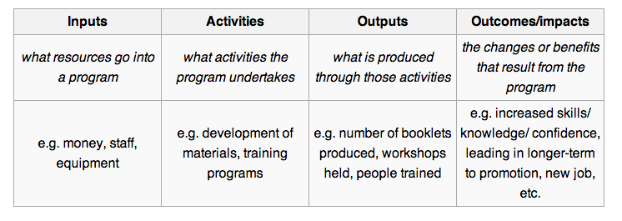

Slide 8
Program Action Logic Model
Inputs (what we invest)
Outputs:
Activities (the actual tasks we do)
Participation (who we serve; customers & stakeholders)
Outcomes/Impacts:
Short Term (learning: awareness, knowledge, skills, motivations)
Medium Term (action: behavior, practice, decisions, policies)
Long Term (consequences: social, economic, environmental etc.)

Slide 9
Outcomes and Outputs: are they different?
Processes deliver Outputs.
In other words, what pops out of the end of a process is an output.
If you were running a Project, you’d probably call it a Deliverable.
Process example:
Recruit Staff - - - - - Newly Appointed People
Prepare a Meal - - - - - A Meal

Slide 10
OUTPUT to outcome
Outputs are only produced (or should only be produced) because there is a customer of the process who wants them.
Customers usually have expectations about both the process and the output (how they get what they want, and what they actually get). That’s where Outcomes fit in.

Slide 11
An OUTCOME is a level of performance
OR achievement.
Outcomes imply quantification of performance.
Because it’s about performance levels, you can’t get your hands on an Outcome!
Our Meal might be:
• too hot, or too cold (Temperature)
• too much to eat (Quantity)
• tasty, or disgusting (Customer Perception)

Slide 12
Program Action: Logic Model
Outcomes
Activities/ Outputs
Situation
Inputs
Knowledge & Behavior
Impacts
Identify
Problem
or Need
Invest
Staff,
Volunteers,
Money,
Materials
Deliver
Products
or
Services
Change in
Program
Participants
Change to
Population
or Area
Notes:
In order to distinguish the differences between Outputs, Outcomes, and Impacts we need to understand the continuum of Program Action.
Logic model helps us figure out the results of our programs - what to measure and demonstrate our accountability.
How many people are familiar with the Logic Model? How many use the Logic Model for their Program Development?
Activities & Outputs are often listed separately in Prog. Eval. they are technically different:
Activities are what we do in research Extension Education.
Outputs are what comes out from funded activities, the products or services.
For reporting purposes there is often overlap, like in DANRIS:
Ex. classes. What we did – teach; Output: 10 classes.
Given that ANR’s mission to be an agent of change, all what we do fits in somewhere along this continuum. Often our work is focused on Outputs and Outcomes, but there is till an impact connected to our work.
In the case of a basic research project, you can take an institutional approach to the Logic Model, and think about the team effort that leads to the long-term outcomes.
Or in the case that a prog./proj. is only at the outputs stage use the logic Model to help determine what the outcomes and impacts will be. Please include in Plan.

Slide 14
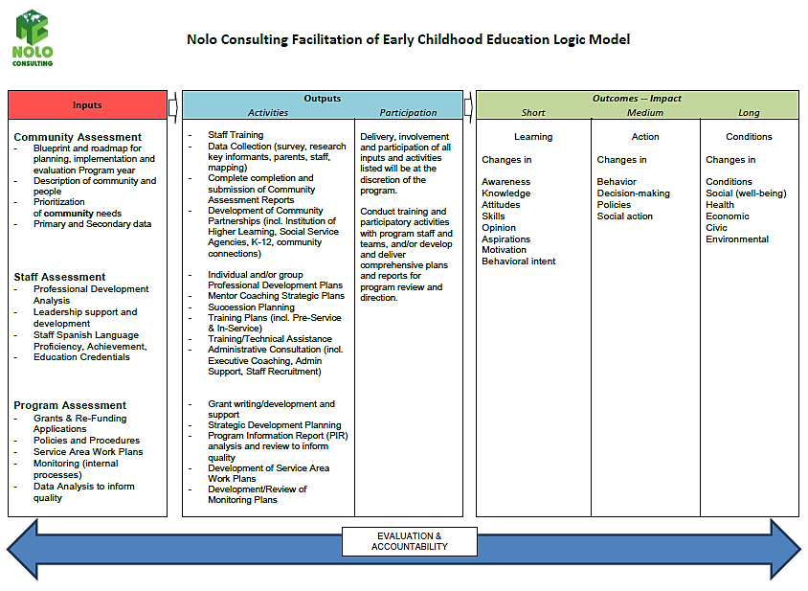

Slide 15
Connecting School Readiness to Family Engagement
School Readiness Goal
Children will demonstrate growing control of large muscles for movement, navigation, and balance.
Program Goal
Program will improve the use of outdoor time ensuring that teachers plan outdoor activities and interact with children during outdoor time.
Family
Engagement
Provide information to families about I Am Moving, I Am Learning.
Provide Professional Development on I Am Moving, I Am Learning.
Staff monitor outdoor time weekly plans.
Share gross motor activities for families to use at home.
Encourage families to share information with program staff about what gross motor activities their children favor at home.
Notes:
Taking it to the next level, SR can also be aligned with Family Engagement by being thoughtful about engaging families in the SR process and defining the activities that programs will undertake in order to increase family engagement to support SR goals.

Slide 16
Program and family engagement goals support school readiness in young children
School Readiness Goal: Children will use math regularly and in everyday routines to count, compare, relate, identify patterns, and problem solve.
Program Goal: Program will ensure teachers have the appropriate training, and access to materials to support the development of math skills in children. | Family Outcome Goal: Help Families connect with their children in positive ways. Activity: Provide families with training on supporting development of math skills in children.

Slide 17
Measuring effort
Family Outcome Goal: Help families connect with their children in positive ways
Program Activity: Provide families with training on supporting development of math skills in children
Measure: Number of parents who attended training (Measuring Effort: count how much and what family programming is offered)

Slide 18
Probing questions
Do your staff understand the connection between Family Engagement and School Readiness?
Do your family engagement goals align with the School Readiness goals?
Are there program goals supporting family engagement and school readiness goals?
How do you measure progress on family engagement goals and connect with child outcomes?

