Slide 1
Work Culture: A Family or a Team? Why should we care?
September 25, 2015
Telamon Migrant Head Start
Central Carolina Community College Meriello Building, Room 135

Slide 2
Working Group Tables

Slide 4
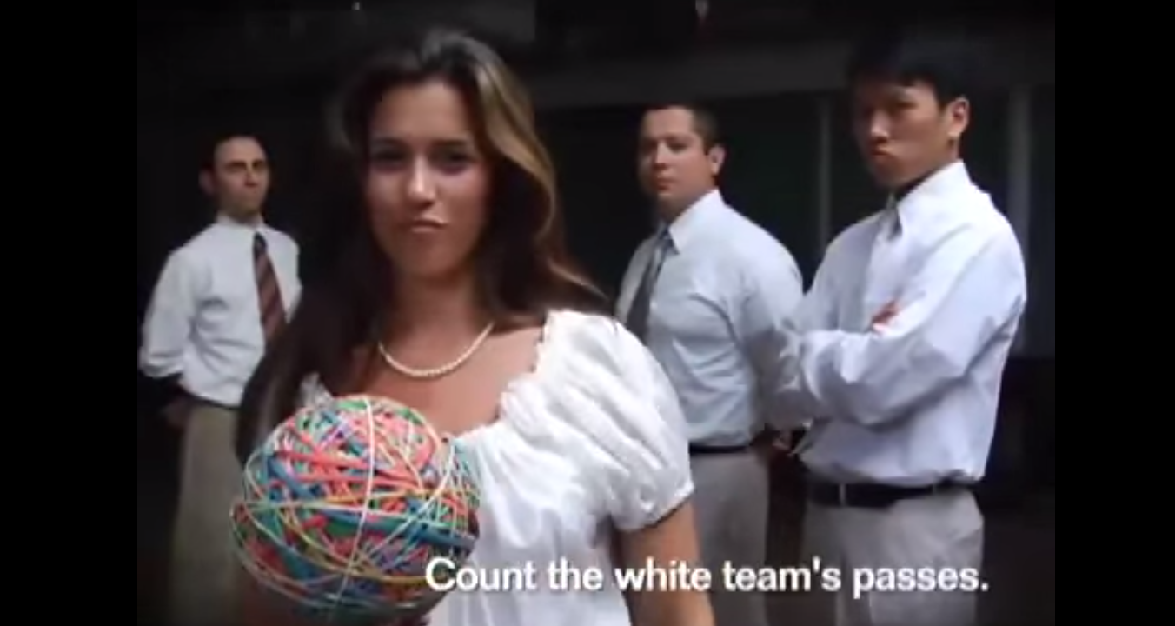
Video: Count the number of passes
https://www.youtube.com/watch?v=1D07neiB7HI

Slide 5
Culture Plays Big Role in Employee Attitudes
Culture contrasts
“In the United States, people used a lot of sports metaphors”
"In Latin America, for example, many people referred to co-workers as family."
Q. What are the expectations of these two contrasts? . . .
Q. What you might expect from your family versus what you might expect from your sports team?

Slide 6
Change and Leadership
We are all Leaders. Leadership is Not a Position, It's a Mindset
How do you considers all perspectives when resolving issues in order to increase collaboration?
Do you understanding style preferences of your colleagues at work to improve teamwork while taking advantage of the strengths that each style brings to your organization?
Can you deal with and sustain change in challenging times?

Slide 7
Change Style Indicator
CSI DOES:
Offer an explanation of preferred style of initiating and dealing with change
Describe three change style preferences that are more personality influenced than situational influenced
Create an appreciation for change-style diversity
CSI DOES NOT:
Present a right or wrong, “better” or “worse” change style
Measure level of competence at initiating and managing change
Limit individuals to predetermined responses to change

Slide 8
CHANGE STYLE PREFERENCE
Change Style Preferences
CONSERVERS
Accept the structure
Prefer change that is incremental

Slide 9
CHANGE STYLE PREFERENCE
Change Style Preferences
CONSERVERS
Accept the structure
Prefer change that is incremental
ORIGINATORS
Challenge the structure
Prefer change that is expansive

Slide 10
CHANGE STYLE PREFERENCE
Change Style Preferences
CONSERVERS
Accept the structure
Prefer change that is incremental
PRAGMATISTS
Explore the structure
Prefer change that is
functional
ORIGINATORS
Challenge the structure
Prefer change that is expansive

Slide 11
CONSERVERS
When facing change CONSERVERS
Generally appear deliberate, disciplined, and organized
Prefer change that maintains current structure
May operate from conventional assumptions
Enjoy predictability
May appear cautious and inflexible
May focus on details and the routine
Honor tradition and established practice

Slide 12
ORIGINATORSCS
When facing change ORIGINATORS
May appear unorganized, undisciplined, unconventional and spontaneous
Prefer change that challenges current structure
Will likely challenge accepted assumptions
Enjoy risk and uncertainty
May be impractical and miss important details
May appear as visionary and systemic in their thinking
Can treat accepted policies and procedures with little regard

Slide 13
PRAGMATISTS
When facing change PRAGMATISTS
May appear practical, agreeable, flexible
Prefer change that emphasizes workable outcomes
Are more focused on results than structure
Operate as mediators and catalyst for understanding
Are open to both sides of an argument
May take more of a middle-of-the-road approach
Appear more team-oriented

Slide 14
ORIGINATORS see CONSERVERS as: ONS
Dogmatic
Bureaucratic
Yielding to authority
Having their head in the sand
Preferring the status quo
Lacking new ideas

Slide 15
CONSERVERS see ORIGINATORS as: ONS
Divisive
Impulsive
Lacking appreciation of tested ways of getting things done
Starting but not finishing projects
Not interested in follow through
Wanting change for the sake of change
Not understanding how things get done

Slide 16
PRAGMATISTS can be perceived by strong CONSERVERS and ORIGINATORS as: PTIONS
Compromising
Mediating
Indecisive
Easily influenced
Noncommittal
Hiding behind team needs

Slide 17
Predict your score… Place yourself in order on the u-shaped line based upon your predicted score Scores range from Left Side 66 to Right Side 66 with a 0 in the middle

Slide 18
COLLABORATION CONSERVERS PRAGMATISTS ORIGINATORS
COLLABORATION
Prefer to keep Prefer balanced Prefer to challenge current structure inquiry accepted structure operating smoothly
Focus on Focus on shared Focus on relationships objectives the task
Encourage building Encourage looking Encourage exploring on what is already at the current new possibilities working circumstances

Slide 19
CREATIVITY CONSERVERS PRAGMATISTS ORIGINATORS
Creativity
Verification Perspiration Inspiration
Refine Concretize Conceptualize
Follow Implement Initiate through

Slide 20
CSI CONTINUUM

Slide 21
Conservers CONTRIBUTIONS TO THE ORGANIZATION
Get things done on schedule
Work well within organizational structure
Attend to detail and factual information
Demonstrate strong follow-through skills
Encourage and adhere to routine
Respect rules and authority
Handle day-to-day operation efficiently

Slide 22
Pragmatists CONTRIBUTIONS TO THE ORGANIZATION
Willing to address the needs of the organization as they arise
Get things done in spite of the rules, not because of them
Negotiate and encourage cooperation and compromise to get problems solved
Take a realistic and practical approach
Draw people together around a common purpose
Organize ideas into action plans
Have short- and long-range perspectives
Promote practical organizational structure

Slide 23
Originators CONTRIBUTIONS TO THE ORGANIZATION
Understand complex problems
Bring strong conceptual and design skills
Push the organization to understand the system as a whole
Support and encourage risk-taking behavior
Provide future-oriented insights and vision for the organization
Serve as catalysts for change
Initiate new ideas, projects, and activities

Slide 24
Conserver Style POTENTIAL PITFALLS
May be rigid in thought and action
May discourage innovation by promoting existing rules, policies and regulations
May not see beyond the present details to understand the broader, strategic context
May delay completion of tasks because of perfectionism
May delay action by reflecting too long on a situation
May appear unyielding and set in their ways
May overly focus on small details and inconsistencies

Slide 25
Pragmatists Style POTENTIAL PITFALLS
May appear indecisive and undirected
May not promote ideas and priorities enough
May try to please too many people at the same time
May appear noncommittal
May be easily influenced
May negotiate compromise that is too “middle of the road”

Slide 26
Originator Style POTENTIAL PITFALLS
May not adjust their vision to the facts, logic, and practical constraints of the situation
May become lost in theory, ignoring or forgetting current realities
May over extend themselves
May not adapt well to policies and procedures
May appear unyielding and discourage others from challenging them
May ignore the impact of their ideas on the system and other people
May move on to new ideas or projects without completing those already started
May overlook relevant details

Slide 27
Suggestions for Increasing Flexibility and Avoiding Style Traps
In General
Consult with a person you believe to have a change style different from yours before proceeding
Make efforts to understand the perspectives of those with styles other than your own.
Imagine putting on a hat of another style.
Solicit feedback and suggestions.
Step back and be aware of your initial reaction in a situation, especially when you are aware of having an emotional response.

Slide 28
The Ten Values of Excellent Teams
Organizational and team values are about the culture we should encourage, the standards we should have, and the principles that should underpin the team’s efforts.
They are the essential building blocks of teambuilding.
Values in teams are the specific beliefs about what is right and wrong around us.

Slide 29
Team Values
Over time all other things may change – an organization’s people, strategy, finances, beneficiaries – but its values should not.
If these are allowed to degenerate, a team no longer has any unifying core.

Slide 30
Excellent teams have ten core team values:
Listening to each other with an open mind without interruption
Sharing knowledge, information and experience with those who can benefit
Taking key decisions based on reasoning, not rank
Expressing concerns only to those responsible for dealing with them
A responsibility culture not a blame culture
Basing our work on the ‘customer’
Striving for continuous improvement
Behaving with integrity
Positively challenging dishonesty or destructive behavior
No ego

Slide 31
Team Values
The Green values are about involving people, and ensuring decisions have a broader base of expertise
The Red values are ‘results’ values
The Blue values are about ethical and cohesive behavior

Slide 32
Values
Terminal values are the end-state we hope to achieve in life.
Instrumental values are means of achieving these terminal values.

Slide 33
ROKEACH VALUES SURVEY
Terminal values (end-state)
A comfortable life
An exciting life
A sense of accomplishment
A world at peace
A world of beauty
Equality
Family security
Freedom
Happiness
Inner harmony
Mature love
National security
Pleasure
Salvation
Self-respect
Social recognition
True friendship
Wisdom
Instrumental values (means to achieve)
Ambitious
Broad-minded
Capable
Cheerful
Clean
Courageous
Forgiving
Helpful
Honest
Imaginative
Independent
Intellectual
Logical
Loving
Obedient
Polite
Responsible
Self-controlled

Slide 37
Telamon Code of Ethics
honestly and ethically wherever we operate
honesty, fairness, respect, responsibility, integrity, trust and sound, informed judgment
The ethical performance of this company is the sum of the ethics of the people who participate in our mission
never permit their personal interests to conflict, or appear to conflict, with the interests of the company or its program recipients
avoid gifts, gratuities, fees, bonuses or excessive entertainment offered to them in return for business
obey all Equal Employment Opportunity laws, including prohibitions against sexual harassment
not promulgating rumors or other speculative perceptions

Slide 38
War on Poverty
In 1964, President Lyndon B. Johnson declared War on Poverty. It consisted of three weapons: education, income maintenance and jobs.
In 1965, the Johnson Administration launched Project Head Start, now Head Start to help meet the needs of pre-school children from low-income families.
The comprehensive services to meet emotional, social, health, nutritional and psychological needs.
At that time, part of the new government thinking on poverty and on how to effectively use education was that the government was obligated to help disadvantaged groups in order to compensate for social or economic inequalities.
In 1969, the government launched Migrant Head Start to ensure children from families that migrate to work in agriculture have access to the same educational advantage available to other low-income children.
In 1998, Congress expanded Migrant Head Start to serve children from seasonal farm worker families and changed the program’s name to Migrant and Seasonal Head Start.

Slide 39
Farmworkers and their families
94% percent of migrant farmworkers in North Carolina are native Spanish speakers.
According to the 2005 NAWS of the USDL, farmworkers nationally are younger than 31 yrs. of age, 80 % are male, 75 % were born in Mexico, 13 % have completed high school, and the median highest grade completed is the sixth grade.
Nationally, farmworkers’ average annual income is $11,000; for a family it is approximately $16,000.
Farmworkers on the East Coast earn about 35% less than the national average.
Many farmworkers and their families in NC live in poverty. Most farmworkers are exempt from minimum wage laws, and all are exempt from overtime provisions, despite long workdays during peak harvest.
Under North Carolina law, farmworkers are not covered under workers compensation—the minimum safety net for workers injured in the job.
Nearly five out of ten North Carolina farmworkers cannot afford enough food for themselves and their families.

Slide 40
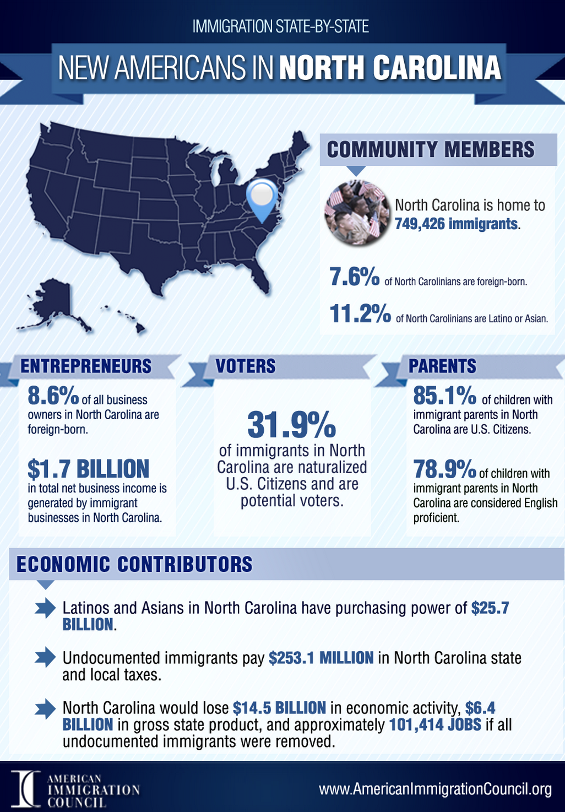
Source: American Immigration Council
http://www.immigrationpolicy.org/just-facts/new-americans-north-carolina

Slide 41
Mentor/Peer Coaching
Each person has an inner wisdom that can provide guidance and understanding, but this wisdom is often obscured by interference from internal and external sources.
The peer coaching process helps individuals work through this interference. The purpose of peer coaching is not to advise or to “fix” people but to help others remove obstacles so they can reveal their own inner wisdom.
After all, self-discovery is more meaningful than problem solving offered by others, no matter how sincere the intentions

Slide 42
Mentor/Peer Coaching help others?
Can you help others resolve their leadership issues by posing only questions?
Can you listen without trying to fix a problem?
Can you listen without prejudice or judgment?
Can you foster growth and change in others?
Can you help your peers look forward and not to the past?
Can you ask open, honest, probing, challenging, and unloaded questions?
Can you ask questions from caring rather than from curiosity?
Can you ask questions from your intuition as well as from what you know?
Can you respect silence?
Can you ask questions simply and briefly?

Slide 43
What is a good Mentor/Peer Coaching?
They can be fairly easy to spot — easier than you might think! Look for those who:
Are patient.
Experiment with different ways to ensure that learning happens.
Like working with adults.
See others’ qualities and strengths.
Want to provide clarity not “fix someone.”

Slide 44
Effective Meetings
Most teams waste time during meetings catching up about personal things.
Before you start a meeting, have a reason for it.
Tell each individual team member what he or she need to bring to each meeting and set an agenda. This way, you can measure the success of a meeting.
Don’t feel like the meeting has to be an hour or two hours – make it more about the tasks at hand because the more time people spend in the meeting, the less time they have to do work.

Slide 49
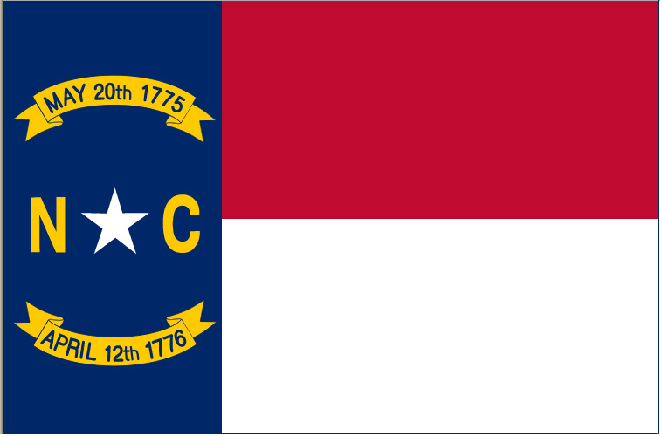

Slide 51
Teacher or Student? Open yourself to the gift and mystery
https://www.youtube.com/watch?v=PFzepCMwuO8

Slide 52
Questions?
www.noloconsulting.com

