Slide 1
Using Your Individual Program Data to Measure Impact and Improve Decision Making
March 19, 2015
Jackson, Mississippi

Slide 2
Agenda
Welcome and Introductions
Review of Training Sessions I and II
Parking Lot Items
Defining Program Goals and Objectives [Action Plans]
Data Plans
Training Background, Objectives and Expectations
To increase understanding of the need to analyze and evaluate data for program improvements
To practice using program data for data analysis;
To receive information to apply in the evaluation of program data analysis in order to facilitate program improvement.
How do we organize our data for analysis?
Data, data quality, measures, and relationships
Quantitative Data Examples and Practice
Qualitative Data Examples and Practice
Practice: Alignment of Program Goals for Successful Five Year Program Implementation
Wrap Up and Q & A

Slide 3
Action Plan – Goal 1
Program Goal: The agency will change the culture of the importance of daily attendance.
Objectives: To obtain perfect attendance.
Expected Outcome(s): Increase the amount of students that have perfect attendance.

Slide 4
Suggested Version Goal 1
Program Goal: “Name” Head Start Program will raise awareness and support the implementation of “attendance matters culture” and engage children, families, schools, and the entire community.
Objectives: “Name” Head Start Program will monitor attendance data regularly [weekly] to identify students who are absent 10 percent of the time, and provide the families early intervention and increase parental awareness about the importance of school attendance, arriving on-time, and the resources/supports available.
Outcome: Create a positive center climate, increase engagement with children and families through family involvement; create a culturally responsive environment; educate parents about the risk factors of absenteeism, and support school readiness.

Slide 5
Action Plan – Goal 2
Program Goal: Improve agency communication support systems.
Objectives: To replace existing telecommunication links with high speed Internet at all centers. Replace all old telephone systems at all systems.
Expected Outcome(s): Improved access to all business applications for tracking HS systems and more reliable two-way communication with parents and staff.

Slide 6
Action Plan – Goal 2
Program Goal: The agency will improve its technological capabilities, which will enable the program to effectively communicate with staff, parents and the community.
Objectives: To install a communication system at 5 HS/EHS centers that will enable staff to communicated effectively throughout the centers.
Expected Outcome(s): Staff will effectively communicate needs, concerns and pertinent information to ensure the safety and well being of staff and children.

Slide 7
Action Plan – Goal 2
Program Goal: The agency will improve technology every three to five years.
Objectives: To enhance the productivity of our staff.
Expected Outcome(s): To have more exposure for children and staff and improve the day-to-day business operation flow.

Slide 8
Suggested Version Goal 2
Program Goal: ABC Head Start will run a state of the art technology system with networks that give access to information and applications that are appropriate for an organization with a mission to empower individual and improve communities.
Objective: ABC Head Start will install high-speed Internet at all centers, upgrade telephone communication systems and provide teachers with communication training and tools to enhance their ability to conduct virtual educational conferences with educators, colleagues and parents by the end of 2015.
Outcome: Well-thought-out technology plans can lead to greater productivity, increased staff morale, and improved service to families, community partners and children.

Slide 9
Action Plan – Goal 3
Program Goal: Expand our reach to local families in and outside of program by bringing quality services including health, mental health and education services.
Objectives: To partner with school districts to locate [HS] eligible children.
Expected Outcome(s): Increase the number of children who are school ready, increase health awareness and decrease health and dental issues.

Slide 10
Suggested Version Goal 3
Program Goal: “Name” Head Start Program will be recognized as the most accessible and effective Early Childhood Education agency connecting parents and “most at need” communities with information on quality and comprehensive services offered to young families in the county.
Objectives: “Name” Head Start Program will lead a collaboration with Public School District and Health Department leadership and organize three events (Spring, Summer and Fall) to promote registration and health clinic open house at Head Start locations across the county.
Outcomes: Increase knowledge of parents and most at need communities about access to health services and empower parents to enroll children early childhood programs that satisfy their educational and developmental needs.

Slide 11
Question Check . . . Goal
Do program goals give voice to the shared vision within your program and help everyone?
Does it goes beyond current expectations?
Is it Organization-wide?
Is it supported or based on a current Community Assessment and Self-Assessment data?
Does it reflect where the program wants to be 5 years from now?
Does it address legacy expectations to the children, families, and the communities you serve?
Does it include “innovation” in addition to “compliance”?
Does not only meet the Head Start Program Performance Standards but strengthen services for children and families?
Does it motivate by engaging emotions?

Slide 12
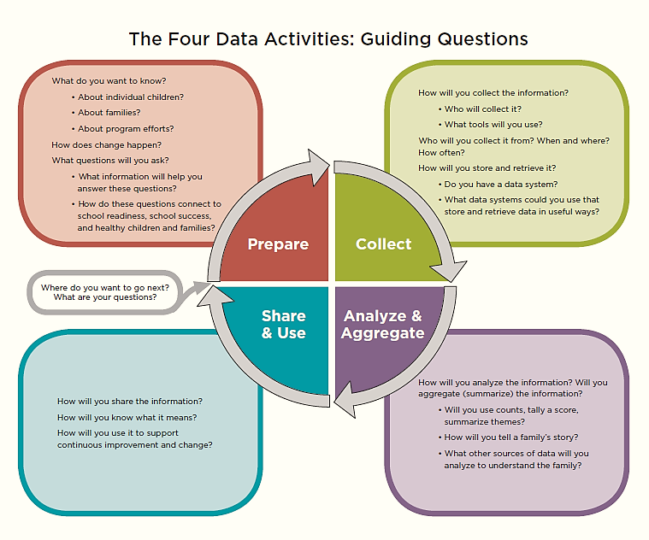

Slide 13
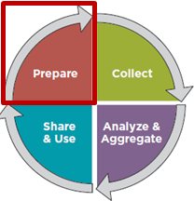
Data Activities: 1. Prepare
What do we do? And Why?
Head Start program operations are guided by:
Head Start Program Performance Standards (HSPPS),
Other federal and state regulations,
Local licensing requirements,
Community factors, and
Goals/mission of the agency (example: To make the most positive impact on the school readiness of the child.)
A process for data collection and analysis should be consistent with these and other regulations.

Slide 14
Data Activities: 1. Prepare
What do we want to know?
The first step in the data analysis process is to forming one or more specific questions to be examined.
Are the questions worded in a way that was consistent with federal standards, other regulations, and organizational purposes?
Are the questions effective in guiding the collection and analysis of data?
Questions can ask for general or limited information.
Notes:
Data Analysis Process Key Components: Purpose & Questions
While some context issues are not under the direct control of the agency or program, they do represent issues that need to be considered as they investigate issues over which they do have influence.

Slide 15
Data Activities: 1. Prepare
Example: Tying Data Collection to Needs and Goals
Identified Need: Improvement in mathematics problem solving in the elementary grades.
Goal: By May 2004, 85% of 4th grade students in each sub-group will perform at proficient levels in mathematics problem solving as measured by the district math assessment.
Question: How effective is the after-school math tutoring program for English Language Learners?

Slide 16
Data Activities: 1. Prepare
Activities include:
Creating a data plan
Identifying data to collect in order to answer critical questions
Establishing methods for collecting data
Setting clear roles for stakeholders (parents, governing boards, staff, community members) in data collection
Establishing a timeline for data collection

Slide 17
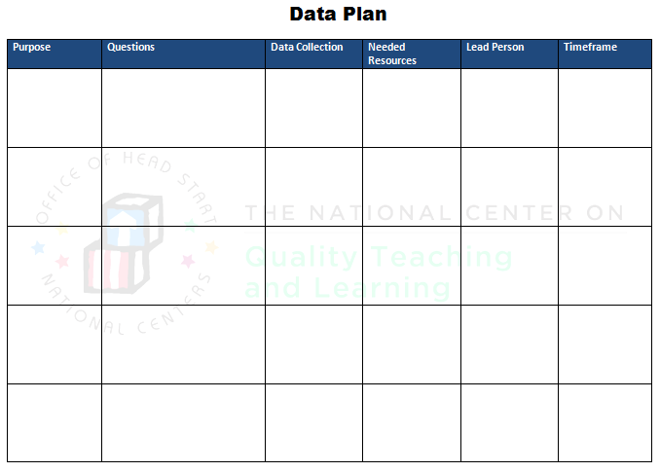

Slide 18
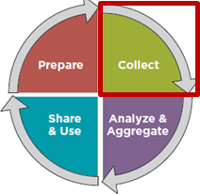
Data Activities: 2. Collect
What information can help us answer our question(s)?
Need to plan data collection carefully [and understand the question well] to avoid the following:
Too little data to answer the question
More data than in necessary to answer the question
Data that is not relevant to answer the question
Notes:
Data Analysis Process Key Components: Data Collection

Slide 19
Data Activities: 2. Collect
Data Collection Sources:
Primary (ex. Observations, questionnaires, interviews, child/family files) vs. Secondary (ex. online resources)
Major data sources in HS and EHS include:
Community Assessment
Program Information Report (PIR)
Ongoing monitoring
Self‐Assessment
Child outcomes data
Federal review reports
Fiscal reports
Health services data tracking
Family services data tracking
Other services related to tracking i.e. mental health, disabilities
Notes:
Data Analysis Process Key Components: Data Collection

Slide 20
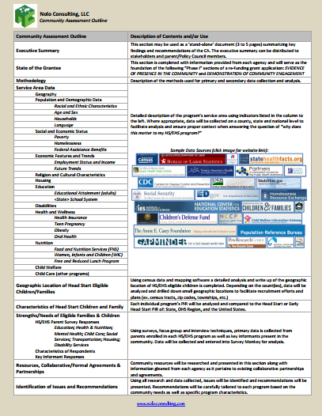
Data Activities: 2. Collect
Secondary Data Collection:
HSES PIR
Community Action CNA
US Census
Other
Primary Data Collection:
Key Informant Surveys
Parent Needs Surveys
Notes:
Data Analysis Process Key Components: Data Collection

Slide 21
Data Activities: 2. Collect
Planning the data collection process
What types of data are most appropriate to answer the questions?
How much data are necessary?
Who will do the collection? Who will enter the data into the record-keeping system?
When and where will the data be collected?
How will the data be compiled and stored?
Who will check for accuracy and how will they do it?
Notes:
Data Analysis Process Key Components: Data Collection

Slide 22
Data Activities: 2. Collect
School Readiness: Children are ready for school, families are ready to support their children’s learning, and schools are ready for children.
The Head Start Child Development and Early Learning Framework | Social and Emotional Development Approaches to Learning Language and Literacy Cognition and General Knowledge Physical Development and Health
Parent, Family and Community Engagement Framework | Family Well-being Parent-Child Relationships Families as Lifelong Educators Families as Learners Family Engagement in Transitions Family Connections to Peers and Community Families as Advocates and Leaders
Framework for Programs Service Infants and Toddlers and Their Families | Enhance Children’s Growth and Development Enhance Parent-Child Relationships Strengthen Families
Notes:
Data Analysis Process Key Components: Data Collection

Slide 23
Data Activities: 2. Collect
School Readiness: Children are ready for school, families are ready to support their children’s learning, and schools are ready for children.
The Head Start Child Development and Early Learning Framework | Social and Emotional Development Approaches to Learning Language and Literacy Cognition and General Knowledge Physical Development and Health
Parent, Family and Community Engagement Framework | Family Well-being Parent-Child Relationships Families as Lifelong Educators Families as Learners Family Engagement in Transitions Family Connections to Peers and Community Families as Advocates and Leaders
Framework for Programs Service Infants and Toddlers and Their Families | Enhance Children’s Growth and Development Enhance Parent-Child Relationships Strengthen Families
Notes:
Data Analysis Process Key Components: Data Collection

Slide 24
Data Activities: 2. Collect
What information can help us answer our question(?)
Are we making progress towards the Family Outcome of Positive Parent-Child Relationships? Are we helping our families connect with their children in positive ways?
Identify indicators of progress:
Measures of effort = count how much family programming is offered, captures what is done by does not tell you if it worked
Measures of effect = measurement of changes in knowledge or behavior as a result of the activity
Notes:
Data Analysis Process Key Components: Data Collection

Slide 25
Data Activities: 2. Collect
Outcome: Positive Parent-Child Relationships Are we helping our families connect with their children in positive ways?
Sample activities to promote outcome | Sample indicators of progress | Sample type of indicator | Sample data collection method(s)
Home visits on parent-child relationship Parenting sessions based on HS child development and early learning framework (STEM focus) | 1. Improved ability of parents to show affection toward their children 2. Increased number of parents who report being better able to handle their children’s challenging behaviors in positive ways 3. Families attending parenting sessions (STEM focused) 4. Parents report being highly satisfied with parenting sessions provided 5. Increased number of parents who report helping their child with math games at home | 1. Effect 2. Effect 3. Effort 4. Effort 5. Effect | 1. Coded observations of parent-child interactions in pre- and post- home visit 2. Survey of families 6 months after participating in home visiting 3. Count of sign-in sheets 4. Workshop evaluation form 5. Survey of families 6 months after participating in parenting sessions
Source: Is My Program Making Progress Toward Family Outcomes?
(A Tool in Development) - Office of Head Start 2nd National Birth to Five Leadership Institute - April 30, 2013
Notes:
Data Analysis Process Key Components: Data Collection

Slide 26
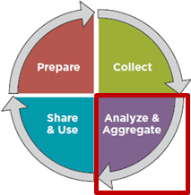
Data Activities: 3. Aggregate and Analyze
How do we organize our data for analysis?
Deciding on how to prepare the data for analysis requires a basic understanding of different types of data and methods for aggregating
Data
Qualitative
Quantitative
Measures
Average / Mean
Median
Mode
Range
Variance
Standard Deviation
Relationships
Dependence
Data Quality
Validity
Reliability
Correlation
Notes:
Data Analysis Process Key Components: Data Analysis Procedures and Methods

Slide 27
Data Activities: 3. Aggregate and Analyze
Two Basic Forms of Data
Qualitative Data: Expressed in verbal or narrative format (focus groups, interviews, open ended questionnaire items). Involving distinctions based on qualities.
Ex. Family Partnership Agreements, Policy Council minutes, Teachers anecdotal records, Mental Health consultant’s observations
Quantitative Data: Expressed in numerical terms – can be measured.
Ex. PIR, child performance tracking, health data tracking, CLASS results
Notes:
Data Analysis Process Key Components: Data Analysis Procedures and Methods

Slide 28
Data Activities: 3. Aggregate and Analyze
Data Quality
Validity: The data represents the contents accurately; assessment tools measures what is actually supposed to measure. “Am I measuring what I think I’m measuring?”
Reliability: The data is dependable or consistent; assessment tools measure whatever it is measuring well, it needs to provide consistent, dependable information each time it is used.
Inter-rater reliability – different assessors/raters reach the same conclusion
Internal consistency – items in the same tool all measure the same area of learning
Test-retest reliability – if the assessment is repeated in a short period of time, you get the same results
Notes:
Data Analysis Process Key Components: Data Analysis Procedures and Methods

Slide 29
Data Activities: 3. Aggregate and Analyze
Measures of Central Tendency: Average or mean
Example 1 (calculating the mean):
Scores = 64, 70, 80, 90, 98, 100
Sum of scores divided by the number of scores:
64 + 70 + 80 + 90 + 98 + 100 = 582
582/7 = 83.14
Example 2 (calculating the mean number of words from 1 to 10 that children in one classroom know):
Sum of scores: 8 + 9 + 10 + 10 + 7 + 6 + 8 + 5 + 9 + 10 = 82
Average = sum of scores divided by number of children = 82 / 10 = 8.2
Child | Abby | Ryan | Jose | Julia | Mike | Sui | Cali | Kyle | Anna | Kim
Score | 8 | 9 | 10 | 10 | 7 | 6 | 8 | 5 | 9 | 10
Notes:
Data Analysis Process Key Components: Data Analysis Procedures and Methods

Slide 30
Data Activities: 3. Aggregate and Analyze
Measures of Central Tendency: Median
The median refers to the score in the middle or at the 50th percentile.
Example 1
Organize scores from smallest to largest
Scores = 64, 70, 80, 80, 90, 98, 100
If the number of scores is odd, find the score in the middle.
64, 70, 80, 80, 90, 98, 100
Median = 80
Example 2
Scores = 64, 70, 80, 80, 90, 98, 100, 100
If there is an even number of score, average the two in the middle.
64, 70, 80, 80, 90, 98, 100, 100
80 + 90 = 170 / 2 = 85
Median = 85
Notes:
Data Analysis Process Key Components: Data Analysis Procedures and Methods

Slide 31
Data Activities: 3. Aggregate and Analyze
Measures of Central Tendency: Mode
The mode is the most frequents response or score.
Example 1
Scores: 6, 70, 80, 80, 90, 98, 100
Mode = 80
Example 2
Scores: 64, 70, 80, 80, 98, 100, 100, 100
Mode = 100
Notes:
Data Analysis Process Key Components: Data Analysis Procedures and Methods

Slide 32
Data Activities: 3. Aggregate and Analyze
Measures of Dispersion: Range and Variance
Class A | Scores | Class B | Scores
Alyssa | 4 | Maria | 1
Derek | 5 | John | 2
Roberto | 6 | Angela | 9
Juliana | 5 | Seth | 8
Keith | 5 | Jacob | 5
AVERAGE | 5 | AVERAGE | 5
Notes:
Data Analysis Process Key Components: Data Analysis Procedures and Methods

Slide 33
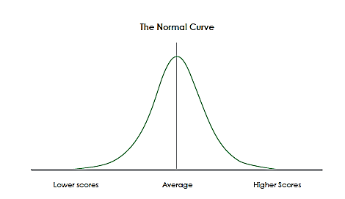
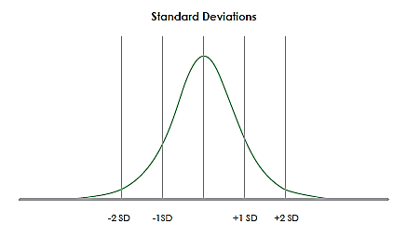
Data Activities: 3. Aggregate and Analyze
Measures of Dispersion: Standard Deviation
The average distance to the mean.
Notes:
Data Analysis Process Key Components: Data Analysis Procedures and Methods

Slide 34
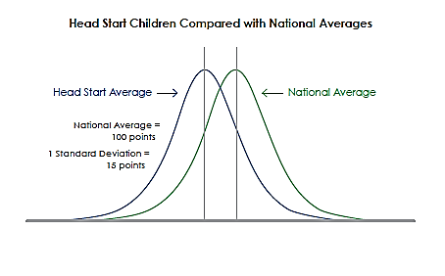
Data Activities: 3. Aggregate and Analyze
Measures of Dispersion: Standard Deviation
Notes:
Data Analysis Process Key Components: Data Analysis Procedures and Methods

Slide 35
Useful Keyboard Shortcuts!
Control | X | Cut
Control | C | Copy
Control | V | Paste
Control | Z | Undo
Control | Y | Redo
Control | A | Select all
Control | B | Bold
Control | I | Italics
Control | U | Underline
Control | F | Find
Control | K | Add hyperlink
Control | Down/Up arrow | Top or bottom cell (furthest)
Control | Left/Right arrow | Left or right cell (furthest)
Control | Home | Navigates to cell A1
Control | End | Navigates to last cell that contains data
Control | Space | Select column
Shift | Space | Select row
Alt | = | Sum all above

Slide 36
Column Chart Useful to show a single point comparison

Slide 37
Clustered Columns Comparing multiple data points across multiple sites

Slide 38
100% Stacked Columns For looking at distribution of factors that equal 100%

Slide 39
Stacked Columns For comparing multiple factors when total does not equal 100%

Slide 40
Pie Chart For looking at distribution of factors that equal 100%

Slide 41
Bar Chart For looking at multiple factors – especially those with long labels

Slide 42
Line Graph To look at data over time

Slide 43
Data Activities: 3. Aggregate and Analyze
Strategies for Quantitative Analysis:
Visualizing the Data: creating a visual “picture” or graphic display of the data
Example: 2013 SAIPE
Exploratory Analysis: Look at the data to identify/describe: “what’s going on?”
Example: TSG Data – Child Outcomes and Growth
Trend Analysis: Looking at data collected at different periods of time
Example: PIR Data 2007-2012
Estimate: Using actual data values to predict a future value
Notes:
Data Analysis Process Key Components: Data Analysis Procedures and Methods
Exploratory Data Analysis – what you do to get familiar with the data (vs. explanatory data analysis)

Slide 44
Data Activities: 3. Aggregate and Analyze
Qualitative Analysis:
Involves identification, examination and interpretations of patters and themes in textual data
Fluid process highly dependent on the evaluator and context of the study
Need to ask yourself:
What patterns or themes emerge?
Are there deviations from the patters?
What story emerges?
Do the patterns suggest additional data needs?
Notes:
Data Analysis Process Key Components: Data Analysis Procedures and Methods

Slide 45
Data Activities: 3. Aggregate and Analyze
What do the results mean?
Presenting the result(s) of the analysis; and,
Providing additional information that will allow others to understand the meaning of the results.
Communicate clearly in a “factual” statement what the data say without any interpretation.
“Factual” observations are the first step in the data analysis process and they provide the basis for making sound inferences.
Not all observations are “factual”
Observations can be colored by biases, assumptions, prejudice
Notes:
Data Analysis Process Key Components: Interpretation / Identification of Findings

Slide 46
Data Activities: 3. Aggregate and Analyze
Data Interpretation Suggested Process
Gather the data set(s) and data displays that relate to the question under investigation and make them available to all team members.
Appoint a note taker for this protocol and record the question that you are investigating on the Data Analysis Worksheet and on a piece of chart paper.
Observe. . . During this step concentrate on making objective observations about what is in the data. Do not attempt to make judgments about why the data may appear as they do.
Take turns making factual observations: “I see, I observe, I notice” and note taker record input.
Remember that inferences you are making need to be based on the evidence you observed in the data.

Slide 47
Data Activities: 3. Aggregate and Analyze
When all observations have been made, review them as a team.
Code or group the observations into categories of findings.
As a team, review the categorized findings.
Make a list of what the team can now infer about the focusing question.
The note taker should record the list on chart paper.
RESULT: List clarifying questions or tentative conclusions

Slide 48
Data Activities: 3. Aggregate and Analyze
Suggested questions for deeper analysis
How do the data sets compare to each other?
What are the commonalities among a given data set?
What patterns or similarities are evident across different data sets?
What inconsistencies or discrepancies (if any) are evident?
Is there anything you expected to see but don’t?
What is not represented in the data?
What questions do the data raise?
What assumptions might be underneath what you are noticing in the data?
What clues help explain why a certain population is meeting or missing targets?
What areas in the data stand out as needing further explanation? Why?
What patterns or themes do you see in the observations?

Slide 49
Data Activities: 3. Aggregate and Analyze
Question:
Observations (without judgment, what the team sees?):
Inferences (What can the team now infer about the focusing question?):
Clarifying Questions or Tentative Conclusions:

Slide 50
Data Activities: 3. Aggregate and Analyze
Aggregate and Analyze…Activities include:
Examining data to identify what is working and what is not working
Identifying trends in needs, strengths, and challenges
Connecting different data types and sources to get a bigger picture
Comparing data, such as conducting a longitudinal analysis that compares the same data from year to year, or comparing Head Start data to external local, state, or national data

Slide 51
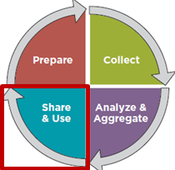
Data Activities: 4. Use and Share
What do we have to say?
This is an opportunities to tell the story of the data you have collected, analyzed, and interpreted.
Good writing is structured to provide information in a logical sequence.
Good writing takes its audience into account.
Notes:
Data Analysis Process Key Components: Writing, Reporting, and Dissemination

Slide 52
Data Activities: 4. Use and Share
How do we tell the story of our data?
Provide findings in relation to a benchmark, such as state findings compared to national or regional findings
Start with giving an overall picture, or highlights, then target specific findings
Include pictures, graphics
When possible include quotes or stories that connect the findings to real people
Break out important information in text boxes to make it more reader friendly
Keep it brief
Refer to the data in the most significant way; 20 percent of the children or 1 in 5 children

Slide 53
Data Activities: 4. Use and Share
How do we tell the story of our data? (cont.)
Use specific numbers when possible and use the most recent data available
Balance the positive and negative of data findings; less than a quarter or more than 75%
Be careful not to generalize when dealing with very small numbers
Explain why findings included in the report are important and how specific audiences could use the data to improve programs.
Always credit the source of the data (when, how, by whom it was collected)
Provide links to additional resources at the end
Include case studies when possible
For some audiences, organize data and present logical illustration of how the data was managed.

Slide 54
Data Activities: 4. Use and Share
Use and Share…Activities include:
Presenting data graphically to provide information in user-friendly ways
Establishing systematic solutions to identified problems
Identifying new goals and new critical questions based on the results of data analysis
Sharing results with stakeholders (staff, parents, governing bodies, community members, etc.)

